Slide 1

Strategic Partnership for Industry 4.0 innovation advanced Training
Common Part – Why should I implement a specific technology?
The European Commission support for the production of this publication does not constitute endorsement of the contents which reflects the views only of the authors, and the Commission cannot be held responsible for any use which may be made of the information contained therein.

Slide 2

Role-play
Each of you will have to point out the reflexion of each part of digitalization process following some questions that we are going to provide to you.
We are going to work in groups of 4
Each of you will have a role in the digitalization process
Costumer, Product, Organization and Systems & Processes

Slide 3
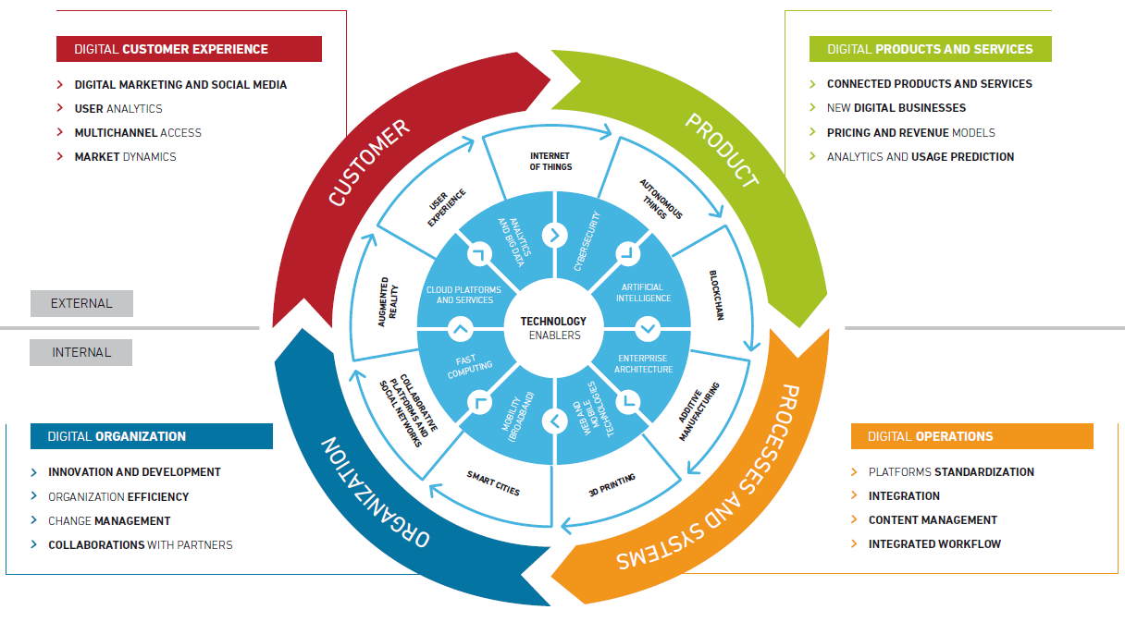
Technology as the engine for the Digital Transformation
Acceso
universal

Slide 4
General reflection
Does the company have the structure to respond to digital transformation?
Is it necessary to modify the structure of the company to succeed in this new era?
Are the traditional industries ready for this changes?
Propose, from the four points of view of the wheel of the digital transformation, a reference model for enterprises 4.0

Slide 5
Costumer
Is it being properly interacting with customers in this new digital environment and new needs and expectations?
Is all the necessary customer information being captured, which facilitates a further analysis of your preferences?
How can digital marketing functions be implemented that are integrated in all channels?
How is sales effectiveness improved by introducing new technology platforms (Optimization of prices and inventory, apps, etc.)?

Slide 6
Product
What new products and services could be offered from the company?
Will digital disruption affect my business model and prices?
What types of innovative income models should I consider? Freemium, subscriptions, announcements, auctions, group purchase, ...?
Can be detected patterns of behaviour in systems that can degenerate into product failures?

Slide 7
Organization
What processes of the company should I update to improve the way of working?
What assets of my company are redundant in this new digital area?
How are employees trained to use digital tools?
How should employees adapt?
Do I need to incorporate new digital roles?
Which companies should I consider to establish collaborations in a digital environment like the current one?

Slide 8
Systems and Processes
In case there are related digital and traditional products, are they well connected?
Are the operations of physical and digital products being optimized at the same time?
Which technologies are best suited to integrate with current systems: ERP, logistics, etc?
Do the technologies used in the company follow the accepted standards to adopt new features?
Does the company's standard platform have adequate security measures?

Slide 9
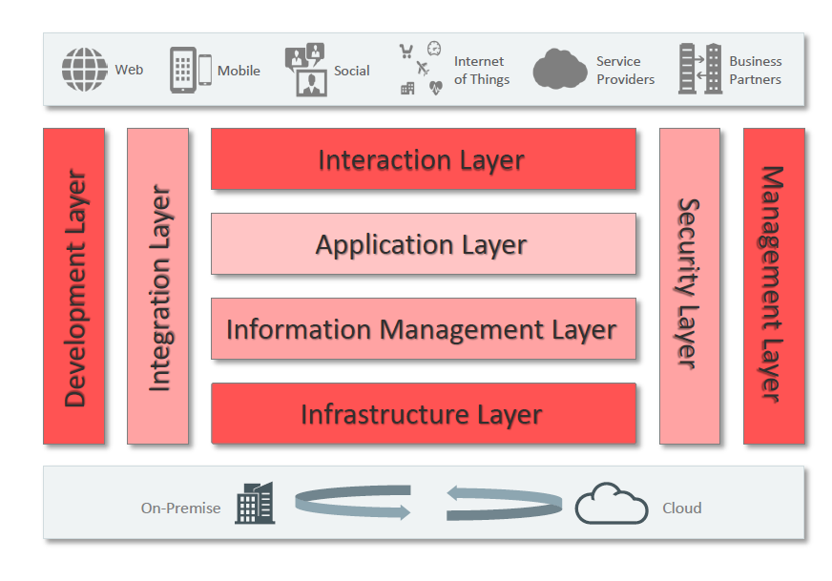
Reference model

